Slide 1
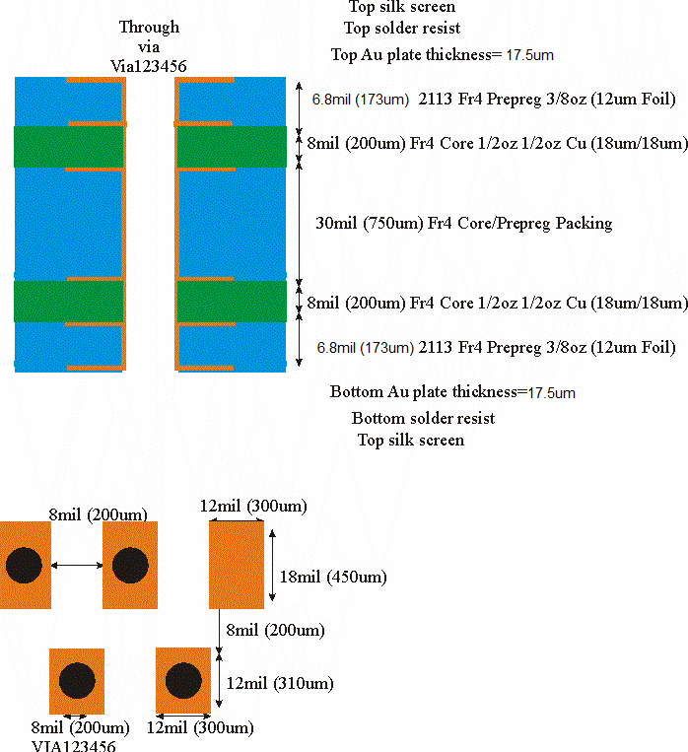
PCB Layer Stack-up

